Slide 1

Adjusting Accounts for
Financial Statements
Chapter 3
Wild, Shaw, and Chiappetta
Fundamental Accounting Principles
23rd Edition
Notes:
Chapter 3: Adjusting Accounts for Financial Statements

Slide 2
Chapter 3 Learning Objectives
CONCEPTUAL
C1 Explain the importance of periodic reporting and the time period assumption.
C2 Explain accrual accounting and how it improves financial statements.
C3 Identify the types of adjustments and their purpose.
ANALYTICAL
A1 Explain how accounting adjustments link to financial statements.
A2 Compute the profit margin and describe its use in analyzing company performance.
PROCEDURAL
P1 Prepare and explain adjusting entries.
P2 Explain and prepare an adjusted trial balance.
P3 Prepare financial statements from an adjusted trial balance.
P4 Appendix 3A Explain the alternatives in accounting for prepaids.

Slide 3
C1:
Explain the importance of periodic reporting and the role of accrual accounting.
Learning Objective

Slide 4
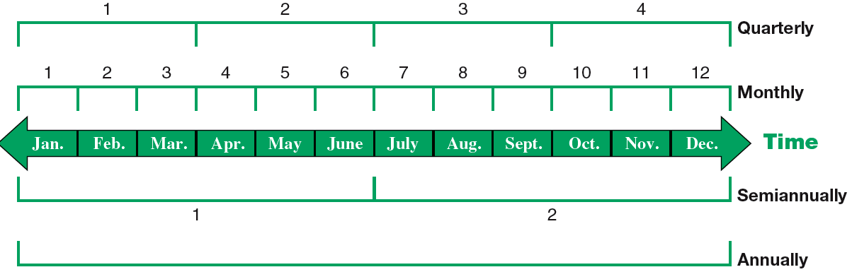
The Accounting Period
Learning Objective C1: Explain the importance of periodic reporting and the role of accrual accounting.
Notes:
To provide timely information, accounting systems prepare reports at regular intervals. This results in an accounting process impacted by the time period (or periodicity) assumption. The time period assumption presumes that an organization’s activities can be divided into specific time periods such as a month, a three-month quarter, a six-month interval, or a year. Most organizations use a year as their primary accounting period. Many organizations also prepare interim financial statements covering one, three, or six months of activity.
When we divide business activities into arbitrary fixed periods of time, it is often necessary to have special accounting for transactions that cross from one time period to the next.
Most of our time will be spent looking at the special adjusting process for some of these transactions.

Slide 5
C2:
Explain accrual accounting and how it improves financial statements.
Learning Objective

Slide 6
Accrual Basis versus Cash Basis
Accrual Basis
Revenues are recognized when earned and expenses are recognized when incurred.
Cash Basis
Revenues are recognized when cash is received and expenses are recorded when cash is paid.
Learning Objective C2 Explain accrual accounting and how it improves financial statements.
Notes:
The accrual basis dictates that revenues be recognized when earned and expenses be recognized when incurred. The accrual basis of accounting is considered to be in compliance with generally accepted accounting principles, or GAAP.
The cash basis of accounting dictates that revenues be recognized when the cash is actually received and that expenses are recorded when the cash is paid.

Slide 7
Accrual Basis versus Cash Basis
Accrual Basis
Revenues are recognized when earned and expenses are recognized when incurred.
Cash Basis
Revenues are recognized when cash is received and expenses are recorded when cash is paid.
Non-GAAP
Learning Objective C2 Explain accrual accounting and how it improves financial statements.
Notes:
The cash basis is not considered to be compliant with GAAP. While you may be on the cash basis for your personal transactions, almost all companies follow the accrual basis of accounting.

Slide 8
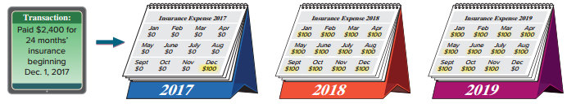
Accrual Basis versus Cash Basis
Exhibit 3.2
On December 1, 2017, FastForward paid $2,400 cash for a twenty-four month business insurance policy.
Using the cash basis, the entire $2,400 would be recognized as insurance expense in 2017. No insurance expense from this policy would be recognized in 2018 or 2019, periods covered by the policy.
Learning Objective C2 Explain accrual accounting and how it improves financial statements.
Notes:
In our first transaction, on December 1, 2017, FastForward paid $2,400 cash for a twenty-four month business insurance policy.
On the cash basis, the entire $2,400 would be recognized as an expense in 2017 even though the policy provides protection for 2017, 2018, and part of 2019. The cash basis balance sheet never reports a prepaid insurance asset because it is immediately expensed.
Let’s look at how this type of transaction is handled in an accrual basis accounting system.

Slide 9
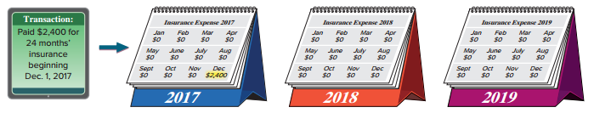
Accrual Basis versus Cash Basis
Exhibit 3.3
On the accrual basis, $100 of insurance expense is recognized in 2017, $1,200 in 2018, and $1,100 in 2019. The expense is matched with the periods benefited by the insurance coverage.
Learning Objective C2 Explain accrual accounting and how it improves financial statements.
Notes:
On the accrual basis, we would record $100 of insurance expense in the month of December, 2017, $100 for each month in 2018, and $100 for the months January through November in 2019. We match the expense with the periods benefited by the insurance coverage. We believe this is a better cost matching of revenues and expenses.

Slide 10
Recognizing Revenues
The revenue recognition principle requires that revenue be recorded when goods or services are provided to customers and at an amount expected to be received from customers.
Learning Objective C2 Explain accrual accounting and how it improves financial statements.
Notes:
With accrual basis accounting, we recognize revenue when the product or service is delivered to our customer. A major goal of the adjusting process is to have revenue recognized (reported) in the time period when those services and products are delivered.

Slide 11
Recognizing Expenses
The expense recognition (or matching) principle aims to record expenses in the same accounting period as the revenues that are earned as a result of those expenses. This matching of expenses with the revenue benefits is a major part of the adjusting process.
Learning Objective C2 Explain accrual accounting and how it improves financial statements.
Notes:
The matching principle aims to record expenses in the same accounting period as the revenues that are earned as a result of those expenses. This matching of expenses with the revenue benefits is a major part of the adjusting process.

Slide 12
C3:
Identify the types of adjustments and their purpose.
Learning Objective

Slide 13
Framework for Adjustments
Four types of adjustments for transactions that extend over more than one period.
Adjustments made using a 3-step process:
Step 1: Determine what the current account balance equals.
Step 2: Determine what the current account balance should
equal.
Step 3: Record an adjusting entry to get from step 1 to step 2.
Learning Objective C3 Identify the types of adjustments and their purpose.
Notes:
Four types of adjustments are necessary for transactions and events that extend over more than one period. Adjustments are made using a 3-step process.
An adjusting entry is made at the end of an accounting period to reflect a transaction or event that is not yet recorded. Each adjusting entry affects one or more income statement accounts and one or more balance sheet accounts (but never the Cash account).

Slide 14
P1:
Prepare and explain adjusting entries.
Learning Objective

Slide 15
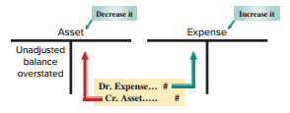
Prepaid (Deferred) Expenses
Prepaid expenses are assets paid for in advance of receiving their benefits.
Examples: Prepaid Insurance, Prepaid Rent, Supplies
Exhibit 3.5
Learning Objective P1: Prepare and explain adjusting entries.
Notes:
Let’s start with the first type of adjusting entries, the payment or receipt of cash before the expense or revenue is recognized.
We will start with a prepaid expense. Prepaid expenses are assets paid for in advance of receiving their benefits.
For all adjustments involving prepaid expenses, we increase, or debit, an expense account and reduce, or credit, an asset account.

Slide 16

Prepaid Insurance
On 12/01/2017, FastForward paid $2,400 to cover insurance for 24 months that began on 12/01/2017.
Recorded as Prepaid Insurance on 12/01/17.
PREPAID INSURANCE
24-month policy
Beginning 12/01
$2,400
Learning Objective P1: Prepare and explain adjusting entries.
Notes:
Step 1: We determine that the current balance of FastForward’s prepaid insurance is equal to its $2,400 payment for 24 months of insurance benefits that began on December 1, 2017.
Step 2: As time passes, the benefits of the insurance gradually expire and a portion of the Prepaid Insurance asset becomes expense. For instance, one month’s insurance coverage expires by December 31, 2017. This expense is $100, or 1/24 of $2,400, which leaves $2,300.
Step 3: The adjusting entry to record this expense will reduce the asset.

Slide 17
Prepaid Insurance
On 12/31, one month’s worth of insurance has expired.
Step 1: Current balance = $2,400
Step 2: Balance in balance in prepaid insurance should equal $2,300.
Step 3: Current prepaid insurance balance $2,400 – 100 = $2,300
PREPAID INSURANCE
INSURANCE EXPENSE
$2,400
$100
$100
$2,400/24 months = $100
Insurance Expense is debited
$100 to recognize the amount
of insurance coverage for Dec. and
Prepaid Insurance is credited for $100
to reduce it’s balance.
Learning Objective P1: Prepare and explain adjusting entries.
Notes:
Now that December is over, we need to remove the cost of one month’s insurance from this account. Insurance expense is debited for $100 and Prepaid insurance is credited for $100.

Slide 18
Prepaid Insurance
(Balance Sheet)
(Income Statement)
PREPAID INSURANCE
INSURANCE EXPENSE
$2,400
adj $100
$100 adj
Bal.
$2,300
The Income Statement will
show $100 (1 month) of
insurance expired!
The Balance Sheet will show
$2,300 (23 months) of
Prepaid Insurance remaining!
Learning Objective P1: Prepare and explain adjusting entries.
Notes:
After the adjustment, the Prepaid Insurance account will show the correct balance of $2,300 on the Balance sheet and the Insurance Expense account will report the correct amount of expired insurance of $100, on the Income Statement.

Slide 19
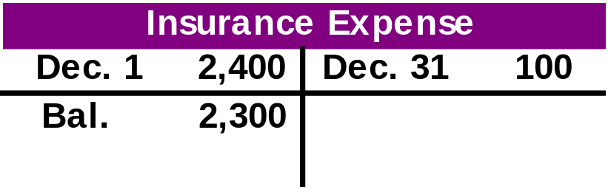

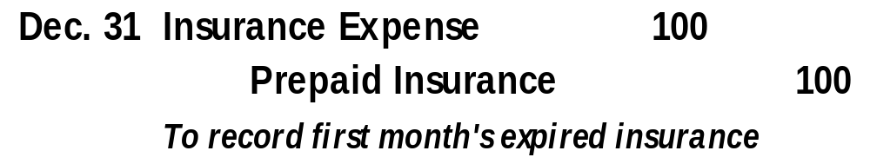
Adjusting Entry for Expired Insurance
The general journal adjustment on Dec. 31 and general ledger account balances are as follows:
637
128
Learning Objective P1: Prepare and explain adjusting entries.
Notes:
16
16
The journal entry to record the adjusting entry for expired insurance includes:
Insurance expense is debited for $100 and Prepaid insurance is credited for $100.

Slide 20
Supplies
Step 1: FastForward purchased $9,720 of supplies in December.
Some of these were used during December.
Step 2: A physical count shows that unused supplies equal $8,670.
Step 3: Adjusting entry reduces Supplies by $1,050 or the difference between the beginning balance and the physical count.
SUPPLIES
Purchases during December
$9,720
Learning Objective P1: Prepare and explain adjusting entries.
Notes:
FastForward purchased $9,720 of supplies in December. Some of these were used during December.
Step 1: Current balance equals $9,720.
Step 2: A physical count shows that unused supplies equal $8,670.
Step 3: Adjusting entry reduces Supplies by $1,050 or the difference between the beginning balance and the physical count.

Slide 21
Supplies
(Balance Sheet)
(Income Statement)
SUPPLIES
SUPPLIES EXPENSE
$9,720
adj $1,050
$1,050 adj
Bal.
$8,670
The Income Statement will
show $1,050 (1 month) of
Supplies expired!
The Balance Sheet will show
$8,670 of supplies remaining!
Learning Objective P1: Prepare and explain adjusting entries.
Notes:
After the adjustment, the Supplies account will show the correct balance of $8,670 on the Balance sheet and the Insurance Expense account will report the correct amount of expired insurance of $1,050, on the Income Statement.

Slide 22
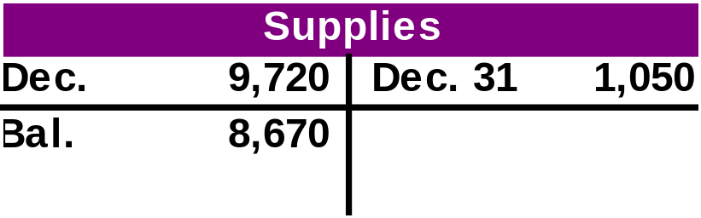

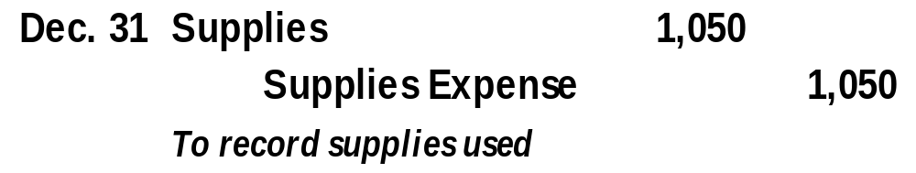
Adjusting Entry for Expired Supplies
We’ve seen the adjustment in the T-accounts but we need to record the adjustment on Dec. 31, in the General Journal
126
652
Learning Objective P1: Prepare and explain adjusting entries.
Notes:
16
16
Part I
During December, FastForward paid a total of $9,720 for supplies. FastForward took a physical count of their supplies and determined that they actually had $8,670 on hand. Let’s look at the adjusting entry we would make on December 31, 2017 to show one month of expired rent.
Part II
We would debit, or increase, the supplies expense account for the difference between the beginning supplies balance and the ending supplies balance or $1,050 and credit, or reduce, the asset supplies account. Now we have recorded the rent expense for December, 2017, we would post the adjusting entry to the two ledger accounts in the general ledger.

Slide 23

Depreciation
Instead of expensing the cost of a plant asset (equipment, building, cars, etc.) in the year it is purchased we allocate or spread out the cost over their expected useful lives.
The formula for straight-line depreciation is:
Straight-Line
Depreciation
Expense
Asset Cost - Salvage Value
Useful Life
=
Learning Objective P1: Prepare and explain adjusting entries.
Notes:
19
19
A special category of prepaid expenses is plant assets, which refers to long-term tangible assets used to produce and sell products and services. Plant assets are expected to provide benefits for more than one period. Good examples of plant assets are building, machines, vehicles and fixtures. Depreciation is the process of allocating the cost of a plant asset over its useful life in a systematic and rational manner. At this point in the accounting process, we want to introduce you to a depreciation method known as straight-line depreciation. Straight line depreciation is the most popular method used by companies. They determine the amount of annual depreciation by taking the cost of the plant assets, subtracting the estimated salvage value and dividing that amount by the useful life of the asset. The salvage value is the amount we expect to receive for the asset when we dispose of it at the end of its useful life. In a later chapter, we will discuss other acceptable methods of depreciation. For now, let’s look at the adjusting entry to record depreciation expense.

Slide 24

Useful Life
The period of time that an asset is expected to help produce revenues.
Useful life expires as a result of wear and tear, or because it no longer satisfies the needs of the business.
Learning Objective P1: Prepare and explain adjusting entries.
Notes:
The useful life of a long-term asset is the period of time that an asset is expected to help produce revenues.
Useful life expires as a result of wear and tear, or because it no longer satisfies the needs of the business.

Slide 25

Salvage Value
The expected market value or selling price of an asset at the end of its useful life
Also called:
  Scrap Value or
  Residual Value
USED. . .
Great condition!
Learning Objective P1: Prepare and explain adjusting entries.
Notes:
The salvage value of an asset is the expected market value or selling price of an asset at the end of its useful life
Also called: Scrap Value or Residual Value.

Slide 26
Straight-line Method
Formula to compute net cost (amount to depreciate):
Original Cost
Salvage Value
Net Cost
=
$26,000
$8,000
=
$18,000
Learning Objective P1: Prepare and explain adjusting entries.
Notes:
To calculate the net cost of the equipment over its useful life, we start with the $26,000 purchase price and subtract the salvage value of $8,000. This leaves a net cost of $18,000 and this is what we will depreciate.

Slide 27
Depreciation Expense
Step 1: FastForward purchased equipment on Dec 1 for $26,000.
Step 2: Equipment has an useful live of 5 years. The equipment is expected to be worth $8,000 at the end of five years. FastForward using straight-line depreciation. $18,000 ($26,000 – 8,000) of the cost needs to be spread over the next 60 months.
One month = $18,000 / 60 = $300.
Step 3: Record adjusting entry for $300 for one month.
Learning Objective P1: Prepare and explain adjusting entries.
Notes:
Let’s look at a depreciation adjustment for FastForward.
Step 1: The company purchased equipment on Dec 1 for $26,000. It has an estimated useful live of 60 months. The equipment is expected to be worth about $8,000 at the end of five years. They purchased the equipment on Dec 1 but it is now Dec 31. We will depreciate the net cost of $18,000 over its useful life of 60 months.
Step 2: Determine depreciation expense for this accounting period (one month) is to use the straight-line depreciation formula. Net cost of $18,000 divided by 60 months of useful life equals a monthly cost of $300. Now that we know depreciation for the month is $300, let’s figure out the adjusting entry.
Step 3: Record the adjusting entry for $300 for on month.

Slide 28
Depreciation adjustment in T-accounts
Equipment
Depreciation Expense
12/1 26,000
12/31 300
Accumulated Depreciation
12/31 300
The depreciation amount of $300 is credited to the
accumulated depreciation account
instead of the asset, Equipment.
Learning Objective P1: Prepare and explain adjusting entries.
Notes:
23
23
The adjustment for depreciation will look like this. We have posted the $300 debit to the Depreciation Expense account and credited a new account called Accumulated Depreciation, for $300. The balance in the Equipment account will remain unchanged by this adjustment. The Accumulated Depreciation account is a contra account and will appear linked to the Equipment account on the Balance sheet. The Depreciation Expense account will appear on our income statement for the year ended December 31, 2017.

Slide 29
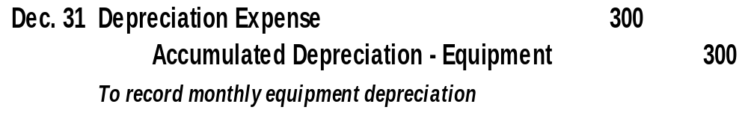
Adjusting Entry for Depreciation
Step 3: Record adjusting entry for $300 for one month.
Equipment
Depreciation Expense
12/1 26,000
12/31 300
Accumulated Depreciation-Equipment
12/31 300
Learning Objective P1: Prepare and explain adjusting entries.
Notes:
22
22
On December 31, 2017, we will debit, or increase, depreciation expense for three hundred dollars and credit a new account called accumulated depreciation – (dash) -- equipment.
Accumulated depreciation is a contra asset account. This is the first time we have seen a contra-account, but it will not be the last. A contra- account means that the amount in the account reduces the related asset account. In our case, accumulated depreciation will reduce the asset account, equipment. Because this is a new type of account, let’s look at the treatment of the contra and related asset account on the balance sheet.

Slide 30
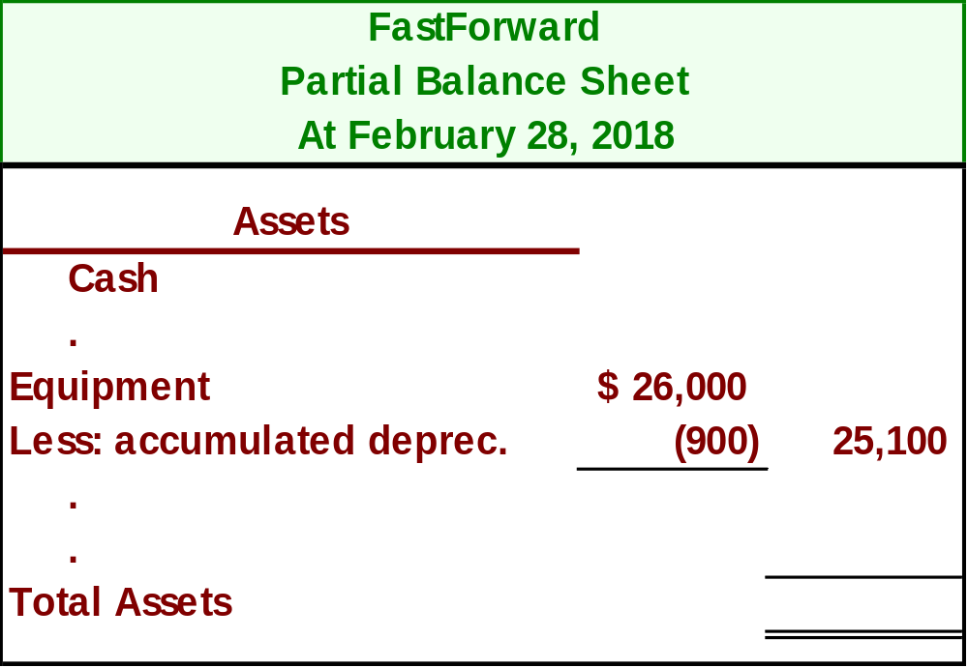
Depreciation on Balance Sheet
Exhibit 3.7
Depreciation would show up on our balance sheet like this:
After three month's of depreciation have been taken, the Equipment is shown net of accumulated depreciation.
$
Learning Objective P1: Prepare and explain adjusting entries.
Notes:
24
24
The contra-account, accumulated depreciation, will be shown as a reduction in the cost of the asset, equipment.
Cost of a plant asset less accumulated depreciation is known as book value. So the asset, equipment, will be shown on the balance sheet at its net amount, or book value. In the partial balance sheet shown on this slide, three months of depreciation have been taken on the equipment for a total of 3 x $300 or $900 dollars. The equipment account is being reported at $25,100 which is the cost that has not yet been depreciated.
Because the contra account appears on the balance sheet it will not be closed at the end of the period. It will be carried forward to 2018 and used to accumulate the depreciation related to the equipment.
Review what you have learned in the following NEED-TO-KNOW Slides.

Slide 31
NEED-TO-KNOW 3-1
For each separate case below, follow the three-step process for adjusting the prepaid asset account.
Step 1:
Determine what the current account balance equals.
Step 2:
Determine what the current account balance should equal.
Step 3:
Record an adjusting entry to get from step 1 to step 2.
Assume no other adjusting entries are made during the year.
Prepaid Insurance.
The Prepaid Insurance account has a $5,000 debit balance to start the year. A
review of insurance policies and payments shows that $1,000 of unexpired insurance remains at year-
end.
Prepaid Rent.
On October 1 of the current year, the company prepaid $12,000 for one year of rent for
facilities being occupied from that day forward. The company debited Prepaid Rent and credited Cash
for $12,000. December 31 year-end statements must be prepared.
Supplies.
The Supplies account has an $1,000 debit balance to start the year. Supplies of $2,000
were purchased during the current year and debited to the Supplies account. A December 31 physical
count shows $500 of supplies remaining.
Accumulated Depreciation.
The company has only one fixed asset (equipment) that it purchased at
the start of this year. That asset had cost $38,000, had an estimated life of 10 years, and is expected
to be valued at $8,000 at the end of the 10-year life.
Learning Objective P1: Prepare and explain adjusting entries.
Notes:
For each separate case below, follow the three-step process for adjusting the prepaid asset account. Step 1: Determine what the current account balance equals. Step 2: Determine what the current account balance should equal. Step 3: Record an adjusting entry to get from step 1 to step 2. Assume no other adjusting entries are made during the year.

Slide 32
NEED-TO-KNOW 3-1 SOLUTION
Prepaid Insurance.
The Prepaid Insurance account has a $5,000 debit balance to start the year. A
review of insurance policies and payments shows that $1,000 of unexpired insurance remains at year-
end.
Step 1: Determine what the current account balance equals.
$5,000
Step 2: Determine what the current account balance should equal.
$1,000
Prepaid Insurance
Unadj.
5,000
Adjustment
4,000
Adj.
1,000
Step 3: Record an adjusting entry to get from step 1 to step 2.
Date
General Journal
Debit
Credit
Dec. 31
Insurance expense
4,000
Prepaid Insurance
4,000
Income Statement
Revenue
Debit Expense
Balance Sheet
Credit Asset
    Liability
Learning Objective P1: Prepare and explain adjusting entries.
Notes:
Prepaid Insurance. The Prepaid Insurance account has a $5,000 debit balance to start the year. A review of insurance policies and payments shows that $1,000 of unexpired insurance remains at year-end.
Step 1: Determine what the current account balance equals. The current account balance is equal to the $5,000 from the start of the year.
Step 2: Determine what the current account balance should equal. The balance sheet should report the $1,000 of unexpired insurance that remains at year-end.
Step 3: Record an adjusting entry to get from step 1 to step 2. We need to reduce the balance in Prepaid insurance by $4,000. Every adjusting entry affects one income statement account, a revenue or an expense, and one balance sheet account, an asset or a liability. In this case, we're reducing the asset, Prepaid insurance. We credit the balance sheet account, Prepaid insurance, for $4,000. Since we're crediting a balance sheet account, we need to debit an income statement account, Insurance expense, $4,000.

Slide 33
NEED-TO-KNOW 3-1 SOLUTION
Prepaid Rent.
On October 1 of the current year, the company prepaid $12,000 for one year of rent for
facilities being occupied from that day forward. The company debited Prepaid Rent and credited Cash
for $12,000. December 31 year-end statements must be prepared.
Step 1: Determine what the current account balance equals.
$12,000
Step 2: Determine what the current account balance should equal.
$9,000
Prepaid Rent
Oct. 1
12,000
Adjustment
3,000
Dec. 31
9,000
Step 3: Record an adjusting entry to get from step 1 to step 2.
Date
General Journal
Debit
Credit
Dec. 31
Rent Expense
3,000
Prepaid Rent
3,000
Income Statement
Revenue
Debit Expense
Balance Sheet
Credit Asset
    Liability
Learning Objective P1: Prepare and explain adjusting entries.
Notes:
Prepaid Rent. On October 1 of the current year, the company prepaid $12,000 for one year of rent for facilities being occupied from that day forward. The company debited Prepaid Rent and credited Cash for $12,000. December 31 year-end statements must be prepared.
Step 1: Determine what the current account balance equals. The current account balance equals the $12,000 paid on October 1.
Step 2: Determine what the current account balance should equal. $12,000 for one year equals $1,000 per month. Three months have elapsed between the payment date, October 1, and the financial statement date, December 31. Nine months of rent remain, and three months of rent have been used. The balance sheet should report the $9,000 that is unused as of December 31.
Step 3: Record an adjusting entry to get from step 1 to step 2. The adjusting entry reduces the balance in the balance sheet account, Prepaid Rent. We credit Prepaid Rent for $3,000, and debit the income statement account, Rent expense.

Slide 34
NEED-TO-KNOW 3-1 SOLUTION
Supplies.
The Supplies account has a $1,000 debit balance to start the year. Supplies of $2,000
were purchased during the current year and debited to the Supplies account. A December 31 physical
count shows $500 of supplies remaining.
Step 1: Determine what the current account balance equals.
$3,000
Step 2: Determine what the current account balance should equal.
$500
Supplies
Unadj.
3,000
Adjustment
2,500
Dec. 31
500
Step 3: Record an adjusting entry to get from step 1 to step 2.
Date
General Journal
Debit
Credit
Dec. 31
Supplies Expense
2,500
Supplies
2,500
Income Statement
Revenue
Debit Expense
Balance Sheet
Credit Asset
    Liability
Learning Objective P1: Prepare and explain adjusting entries.
Notes:
Step 1: Determine what the current account balance equals. The Supplies account has a $1,000 debit balance to start the year. Supplies of $2,000 were purchased during the current year and debited to the Supplies account.
Step 2: Determine what the current account balance should equal. A December 31 physical count shows $500 of supplies remaining. The current account balance equals $3,000; the $1,000 from January 1 plus $2,000 purchased during the year. The current account balance should equal $500, as $500 of supplies remain.
Step 3: Record an adjusting entry to get from step 1 to step 2. The adjusting entry to get from Step 1 to Step 2 reduces the balance in Supplies, crediting the balance sheet account, $2,500, and we debit the income statement account, Supplies Expense.

Slide 35
NEED-TO-KNOW 3-1 SOLUTION
Accumulated Depreciation.
The company has only one fixed asset (equipment) that it purchased at
the start of this year. That asset had cost $38,000, had an estimated life of 10 years, and is expected
to be valued at $8,000 at the end of the 10-year life.
Step 1: Determine what the current account balance equals.
$0
Step 2: Determine what the current account balance should equal.
$3,000
Accumulated Depreciation
Unadj.
0
Adjustment
3,000
Dec. 31
3,000 ($38,000 - $8,000)
10 years
Step 3: Record an adjusting entry to get from step 1 to step 2.
Date
General Journal
Debit
Credit
Dec. 31
Depreciation Expense
3,000
Accumulated Depreciation
3,000
Income Statement
Revenue
Debit Expense
Balance Sheet
Credit Asset
    Liability
Learning Objective P1: Prepare and explain adjusting entries.
Notes:
Accumulated Depreciation. The company has only one fixed asset (equipment) that it purchased at the start of this year. That asset cost $38,000, had an estimated life of 10 years, and is expected to be valued at $8,000 at the end of the 10-year life.
Step 1: Determine what the current account balance equals. This is the first year of the asset's life; no depreciation has been taken to date. The current balance in Accumulated Depreciation is $0.
Step 2: Determine what the current account balance should equal. The balance in Accumulated Depreciation at the end of the first year of this asset's life should be $3,000; the cost of $38,000, minus the salvage value of $8,000, divided by 10 years.
Step 3: Record an adjusting entry to get from Step 1 to Step 2. The adjusting entry needs to credit Accumulated Depreciation for $3,000. Since we're crediting the balance sheet account, we need to debit the income statement account, Depreciation Expense. Accumulated Depreciation is referred to as a contra asset. Its purpose is to reduce the value of the equipment, and therefore has a normal credit balance.

Slide 36
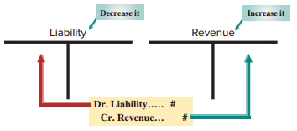
Unearned (Deferred)
Revenues
Exhibit 3.8
Cash received in advance of providing products or services.
Learning Objective P1: Prepare and explain adjusting entries.
Notes:
The term unearned revenues refers to cash received in advance of providing products and services. Unearned revenues, also called deferred revenues, are liabilities.
When accounting for deferred revenues, we are faced with a transaction where cash is received in advance of providing a product or service. In other words, we have received the cash, but have done nothing to earn it. In our example, we will examine accounting for the receipt of cash prior to our company rendering any services.
When we render consulting services, we will prepare an adjustment for deferred revenues (a liability). We always debit, or reduce, a liability account and credit, or increase, a revenue account.

Slide 37

Unearned (Deferred) Revenues
Step 1: FastForward’s client paid 60-day fee in advance covering the period from 12/27 – 2/24 and recorded:
Step 2: FastForwards earns payment as time passes. At 12/31, 5 days’ service is earned or 5/60 x $3,000 = $250.
Step 3: Adjusting entry reduces liability, Unearned Consulting Revenue, by $250 or 5 days’ worth of revenue. Also, Consulting Revenue of $250 is earned.
Learning Objective P1: Prepare and explain adjusting entries.
Notes:
FastForward’s client paid 60-day fee in advance covering the period from 12/27 – 2/24 and recorded a debit to cash and a credit to unearned consulting revenue, a liability account.
Step 1: Current balance equals $3,000.
Step 2: FastForwards earns payment as time passes. At 12/31, 5 days’ service is earned or 5/60 x $3,000 = $250.
Step 3: Adjusting entry reduces liability, Unearned Consulting Revenue, by $250 or 5 days’ worth of revenue. Also, Consulting Revenue of $250 is earned.

Slide 38
Unearned (Deferred) Revenue
(Balance Sheet)
(Income Statement)
UNEARNED CONSULTING REVENUE
CONSULTING REVENUE
$3,000
$5,800
adj $250
250
$6,050
Bal.
$2,750
Bal.
The Balance Sheet will show
$2,750 of Unearned Consulting
Revenue unearned.
The Income Statement will
show $6,050 total Consulting
Revenue earned.
Learning Objective P1: Prepare and explain adjusting entries.
Notes:
After the adjustment, the Unearned Consulting Revenue account will show the correct balance of $2,750 on the Balance sheet and the Consulting Revenue account will report the correct amount of earned revenue of $6,050, on the Income Statement.

Slide 39
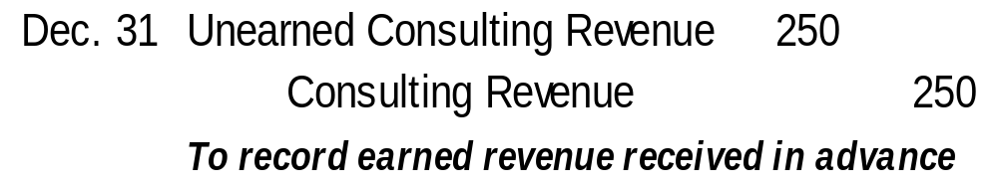
Adjusting Entry for Unearned Revenue
Adjusting entry recorded on Dec. 31 to transfer $250 from unearned to earned consulting revenue.
Learning Objective P1: Prepare and explain adjusting entries.
Notes:
16
16
The journal entry to transfer the $250 earned into the revenue account includes a debit to the liability account, Unearned Consulting Revenue and a credit to the revenue account, Consulting Revenue.
Review what you have learned in the following NEED-TO-KNOW Slides.

Slide 40
NEED-TO-KNOW 3-2
For each separate case below, follow the three-step process for adjusting the unearned revenue liability account.
Step 1:
Determine what the current account balance equals.
Step 2:
Determine what the current account balance should equal.
Step 3:
Record an adjusting entry to get from step 1 to step 2.
Assume no other adjusting entries are made during the year.
Unearned Rent Revenue.
The company collected $24,000 rent in advance on September 1,
debiting Cash and crediting Unearned Rent Revenue. The tenant was paying 12 months rent in
advance and occupancy began September 1.
Unearned Services Revenue.
The company charges $100 per month to spray a house for insects.
A customer paid $600 on November 1 in advance for six treatments, which was recorded with a debit
to Cash and a credit to Unearned Services Revenue. At year-end, the company has applied two
treatments for the customer.
Learning Objective P1: Prepare and explain adjusting entries.
Notes:
For each separate case below, follow the three-step process for adjusting the unearned revenue liability account. Step 1: Determine what the current account balance equals. Step 2: Determine what the current account balance should equal. Step 3: Record an adjusting entry to get from step 1 to step 2.

Slide 41
NEED-TO-KNOW 3-2 SOLUTION
Unearned Rent Revenue.
The company collected $24,000 rent in advance on September 1,
debiting Cash and crediting Unearned Rent Revenue. The tenant was paying 12 months rent in
advance and occupancy began September 1.
Step 1: Determine what the current account balance equals.
$24,000
Step 2: Determine what the current account balance should equal.
$16,000
Unearned Rent Revenue
Sept. 1
24,000
Adjustment
8,000
Dec. 31
16,000 (8 mos. @ $2,000)
Step 3: Record an adjusting entry to get from step 1 to step 2.
Date
General Journal
Debit
Credit
Dec. 31
Unearned Rent Revenue
8,000
Rent Revenue
8,000
Income Statement
Revenue
Expense
Balance Sheet
    Asset
    Liability
Credit
Debit
Learning Objective P1: Prepare and explain adjusting entries.
Notes:
Unearned Rent Revenue. The company collected $24,000 rent in advance on September 1, debiting Cash and crediting Unearned Rent Revenue. The tenant was paying 12 months’ rent in advance and occupancy began September 1. Whenever you see the word "unearned,” it always indicates a liability account. Most liability accounts include the word "payable,” as those liabilities will be paid back. An unearned account is a liability that will be worked off, rather than paid off.
Step 1: Determine what the current account balance equals. The current balance in Unearned rent revenue is the $24,000 that was credited to the liability account on September 1.
Step 2: Determine what the current account balance should equal. $24,000 in rent for one year is $2,000 per month. As of December 31, the tenant has occupied the space for four months: September through December. The company still has a liability for the remaining eight months. The account balance should equal $16,000 as of December 31; eight months at $2,000 per month.
Step 3: Record an adjusting entry to get from step 1 to step 2. The adjusting entry needs to reduce the balance in Unearned Rent Revenue, debiting the liability account for $8,000; 4 months at $2,000 per month.
Every adjusting entry affects one income statement account, a revenue or an expense, and one balance sheet account, an asset or a liability. In this case, we're debiting the balance sheet account, Unearned rent revenue, for $8,000. And since we're debiting the balance sheet, we need to credit the income statement. We credit Rent Revenue for $8,000.

Slide 42
NEED-TO-KNOW 3-2 SOLUTION
Unearned Services Revenue.
The company charges $100 per month to spray a house for insects.
A customer paid $600 on November 1 in advance for six treatments, which was recorded with a debit
to Cash and a credit to Unearned Services Revenue. At year-end, the company has applied two
treatments for the customer.
Step 1: Determine what the current account balance equals.
$600
Step 2: Determine what the current account balance should equal.
$400
Unearned Services Revenue
Nov. 1
600
Adjustment
200
Dec. 31
400
Step 3: Record an adjusting entry to get from step 1 to step 2.
Date
General Journal
Debit
Credit
Dec. 31
Unearned Services Revenue
200
Services Revenue
200
Income Statement
Revenue
Expense
Balance Sheet
    Asset
    Liability
Credit
Debit
Learning Objective P1: Prepare and explain adjusting entries.
Notes:
Unearned Services Revenue. The company charges $100 per month to spray a house for insects. A customer paid $600 on November 1 in advance for six treatments, which was recorded with a debit to Cash and a credit to Unearned Services Revenue. At year-end, the company has applied two treatments for the customer.
Step 1: Determine what the current account balance equals. The current balance in Unearned services revenue is equal to the $600 cash received in advance.
Step 2: Determine what the current account balance should equal. As of December 31, the company still owes four treatments at $100 per month. The December 31 balance in the liability account should equal $400.
Step 3: Record an adjusting entry to get from step 1 to step 2. The adjusting entry debits the liability account, Unearned Services Revenue, for $200, and since we're debiting the balance sheet, we need to credit the income statement, Credit Services Revenue, $200.

Slide 43
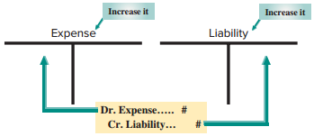
Accrued Expenses
Exhibit 3.9
Costs incurred in a period that are
both unpaid and unrecorded.
Learning Objective P1: Prepare and explain adjusting entries.
Notes:
An accrued expense is defined as a cost incurred in the current period that is both unpaid and unrecorded. When you use your credit card, often you do not record the transaction until you pay your monthly invoice; even though you have incurred the cost. Accrued expenses must be reported on the income statement of the period when incurred.
For all accrued expense adjusting entries, we debit, or increase an expense account, and credit, or increase, a liability account.

Slide 44
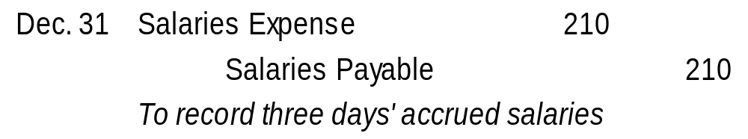
Accrued Salaries Expense
Step 1: FastForward’s pays its employee $70 per day, or $350 for a five-day work. Salaries are paid every two weeks on a Friday.
Step 2: 12/31 is a Wednesday, so three day’s salaries are owed at year end which equals $70 x 3 = $210.
Step 3: Adjusting entry increases a liability, Salaries Payable, and increases the Salaries Expense account for $210 with the following journal entry:
Learning Objective P1: Prepare and explain adjusting entries.
Notes:
Step 1: FastForward’s pays its employee $70 per day, or $350 for a five-day work. Salaries are paid every two weeks on a Friday.
Step 2: 12/31 is a Wednesday, so three day’s salaries are owed at year end which equals $70 x 3 = $210.
Step 3: Adjusting entry increases a liability, Salaries Payable, and increases the Salaries Expense account for $210 with the following journal entry:

Slide 45
Accrued Salaries Expense
(Balance Sheet)
(Income Statement)
SALARIES PAYABLE
SALARIES EXPENSE
adj
$210
$1,400
210
adj
$210
Bal.
$1,610
Bal.
The Balance Sheet will show
$210 of Salaries Payable owed.
The Income Statement will
show $1,610 total Salaries
Expense.
Learning Objective P1: Prepare and explain adjusting entries.
Notes:
After the adjustment, the Salaries payable account will show the correct balance of $210 of salaries owed on the Balance sheet and the Salaries expense account will report the correct amount of salaries expense on the Income Statement.

Slide 46
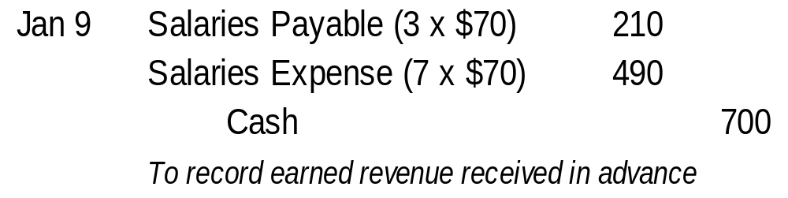
Future Payment of Accrued Expenses
Accrued expenses at the end of one period result in a cash payment in a future period.
On 12/31, FastForward recorded accrued salaries of $210.
On 1/9 of the next year, the following entry will reduce the accrued liability, salaries payable, and record the expense for 7 days work in January.
Learning Objective P1: Prepare and explain adjusting entries.
Notes:
16
16
FastForward recorded accrued salaries of $210. On January 9, the first payday of the next period, the following entry settles the accrued liability (salaries payable) and records salaries expense for seven days of work in January.
The $210 debit reflects the payment of the liability for the three days’ salary accrued on December 31. The $490 debit records the salary for January’s first seven working days (including the New Year’s Day holiday) as an expense of the new accounting period. The $700 credit records the total amount of cash paid to the employee.
Review what you have learned in the following NEED-TO-KNOW Slides.

Slide 47
NEED-TO-KNOW 3-3
For each separate case below, follow the three-step process for adjusting the accrued expense account.
Step 1:
Determine what the current account balance equals.
Step 2:
Determine what the current account balance should equal.
Step 3:
Record an adjusting entry to get from step 1 to step 2.
Assume no other adjusting entries are made during the year.
Salaries Payable.
At year-end, salaries expense of $5,000 has been incurred by the company, but is
not yet paid to employees.
Interest Payable.
At its December 31 year-end, the company holds a mortgage payable that has
incurred $1,000 in annual interest that is neither recorded nor paid. The company intends to pay the
interest on January 3 of the next year.
Learning Objective P1: Prepare and explain adjusting entries.
Notes:
For each separate case below, follow the three-step process for adjusting the accrued expense account. Step 1: Determine what the current account balance equals. Step 2: Determine what the current account balance should equal. Step 3: Record an adjusting entry to get from step 1 to step 2.

Slide 48
NEED-TO-KNOW 3-3 SOLUTION
Salaries Payable.
At year-end, salaries expense of $5,000 has been incurred by the company, but is
not yet paid to employees.
Step 1: Determine what the current account balance equals.
$0
Step 2: Determine what the current account balance should equal.
$5,000
Salaries Payable
Unadj.
0
Adjustment
5,000
Dec. 31
5,000
Step 3: Record an adjusting entry to get from step 1 to step 2.
Date
General Journal
Debit
Credit
Dec. 31
Salaries Expense
5,000
Salaries Payable
5,000
Income Statement
Revenue
Expense
Balance Sheet
    Asset
    Liability
Debit
Credit
Learning Objective P1: Prepare and explain adjusting entries.
Notes:
Salaries Payable. At year-end, salaries expense of $5,000 has been incurred by the company, but is not yet paid to employees.
Step 1: Determine what the current account balance equals. Because this amount is unrecorded, the balance in Salaries Payable is currently $0.
Step 2: Determine what the current account balance should equal. The balance in the liability account should equal the $5,000 that's due to employees at year-end.
Step 3: Record an adjusting entry to get from step 1 to step 2. We need to increase the balance in Salaries Payable by $5,000.
Every adjusting entry affects one income statement account, a revenue or an expense, and one balance sheet account, an asset or a liability. In this case, we need to credit the liability account, Salaries Payable for $5,000. And since we're crediting the balance sheet, we need to debit the income statement; we debit Salaries Expense for $5,000.

Slide 49
NEED-TO-KNOW 3-3 SOLUTION
Interest Payable.
At its December 31 year-end, the company holds a mortgage payable that has
incurred $1,000 in annual interest that is neither recorded nor paid. The company intends to pay the
interest on January 3 of the next year.
Step 1: Determine what the current account balance equals.
$0
Step 2: Determine what the current account balance should equal.
$1,000
Interest Payable
Unadj.
0
Adjustment
1,000
Dec. 31
1,000
Step 3: Record an adjusting entry to get from step 1 to step 2.
Date
General Journal
Debit
Credit
Dec. 31
Interest Expense
1,000
Interest Payable
1,000
Income Statement
Revenue
Expense
Balance Sheet
    Asset
    Liability
Debit
Credit
Learning Objective P1: Prepare and explain adjusting entries.
Notes:
Interest Payable. At its December 31 year-end, the company holds a mortgage payable that has incurred $1,000 in annual interest that is neither recorded nor paid. The company intends to pay the interest on January 3 of the next year.
Step 1: Determine what the current account balance equals. Since the amount due is unrecorded, the balance in Interest Payable is currently $0.
Step 2: Determine what the current account balance should equal. The balance in Interest Payable should equal the amount due; $1,000 as of December 31.
Step 3: Record an adjusting entry to get from step 1 to step 2. We need to credit Interest Payable for $1,000, and since we're crediting the balance sheet account, Interest Payable, for $1,000, we need to debit the income statement account, Interest Expense.

Slide 50
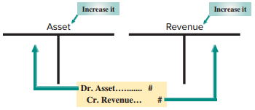
Accrued Revenues
Exhibit 3.11
Accrued revenues are revenues earned in a period that are both unrecorded and not yet received in cash or other assets.
Learning Objective P1: Prepare and explain adjusting entries.
Notes:
The adjusting entry to accrue revenues is needed because many firms have delivered a product or provided a service but have not recorded the revenue in the current period. In our example, a company completes a consulting engagement. The company has earned the revenue, but has not recorded it at year-end. The company has earned interest that will not be paid until the next period as well.
Accrued revenues are revenues earned in a period that are both unrecorded and not yet received in cash (or other assets).
The adjusting entries to record accrued revenue will always debit, or increase, an asset account and credit, or increase, a revenue account.

Slide 51
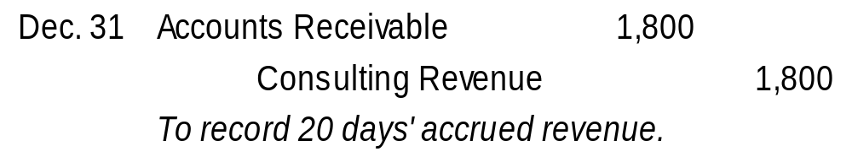
Accrued Services Revenue
Step 1: On 12/12, FastForward’s customer agreed to pay $2,700 on 1/10 of the next year for future services over the next 30 days.
Step 2: 12/31, 20 days worth of services have been provided and earned which totals $1,800 ($2,700 x 20/30 days).
Step 3: Adjusting entry increases an asset, Accounts Receivable, and increases the Consulting Revenue account for $1,800 with the following journal entry:
Learning Objective P1: Prepare and explain adjusting entries.
Notes:
Step 1: On 12/12, FastForward’s customer agreed to pay $2,700 on 1/10 of the next year for future services over the next 30 days.
Step 2: 12/31, 20 days worth of services have been provided and earned which totals $1,800 ($2,700 x 20/30 days).
Step 3: Adjusting entry increases an asset, Accounts Receivable, and increases the Consulting Revenue account for $1,800.

Slide 52
Accrued Services Revenue
(Balance Sheet)
(Income Statement)
ACCOUNTS RECEIVABLE
CONSULTING REVENUE
adj
$1,800
$6,050
1,800
adj
Bal.
$1,800
$7,850
Bal.
The Balance Sheet will show
$1,800 of Accounts Receivable.
The Income Statement will
show $7,850 total
Consulting Revenue
Learning Objective P1: Prepare and explain adjusting entries.
Notes:
After the adjustment, the Accounts receivable account will show the correct balance of $1,800 on the Balance sheet and the Consulting Revenue account will report the correct amount of revenue earned on the Income Statement.

Slide 53
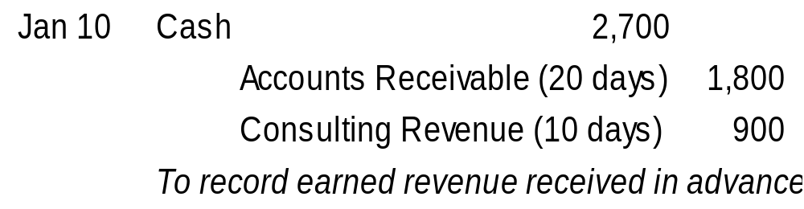
Future Receipt of Accrued Revenues
Accrued revenue at the end of one period results in a cash receipt in a future period.
On 12/31, FastForward recorded accrued revenue earned of $1,800.
On 1/10 of the next year, the following entry will reduce the accounts receivable, record revenue earned for 10 days and receipt of $2,700 cash.
Learning Objective P1: Prepare and explain adjusting entries.
Notes:
16
16
FastForward made an adjusting entry for $1,800 to record 20 days’ accrued revenue earned from its consulting contract. When FastForward receives $2,700 cash on January 10 for the entire contract amount, it makes the following entry to remove the accrued asset (accounts receivable) and recognize the revenue earned in January. The $2,700 debit reflects the cash received. The $1,800 credit reflects the removal of the receivable, and the $900 credit records the revenue earned in January.
Review what you have learned in the following NEED-TO-KNOW Slides.

Slide 54
NEED-TO-KNOW 3-4
For each separate case below, follow the three-step process for adjusting the accrued revenue account.
Step 1:
Determine what the current account balance equals.
Step 2:
Determine what the current account balance should equal.
Step 3:
Record an adjusting entry to get from step 1 to step 2.
Assume no other adjusting entries are made during the year.
Accounts Receivable.
At year-end, the company has completed services of $1,000 for a client, but
the client has not yet been billed for those services.
Interest Receivable.
At year-end, the company has earned, but not yet recorded, $500 of interest
earned from its investments in government bonds.
Learning Objective P1: Prepare and explain adjusting entries.
Notes:
For each separate case below, follow the three-step process for adjusting the accrued revenue account. Step 1: Determine what the current account balance equals. Step 2: Determine what the current account balance should equal. Step 3: Record an adjusting entry to get from step 1 to step 2.

Slide 55
NEED-TO-KNOW 3-4 SOLUTION
Accounts Receivable.
At year-end, the company has completed services of $1,000 for a client, but
the client has not yet been billed for those services.
Step 1: Determine what the current account balance equals.
$0
Step 2: Determine what the current account balance should equal.
$1,000
Accounts Receivable
Unadj.
0
Adjustment
1,000
Dec. 31
1,000
Step 3: Record an adjusting entry to get from step 1 to step 2.
Date
General Journal
Debit
Credit
Dec. 31
Accounts Receivable
1,000
Services Revenue
1,000
Income Statement
Revenue
Expense
Balance Sheet
    Asset
    Liability
Credit
Debit
Learning Objective P1: Prepare and explain adjusting entries.
Notes:
Accounts Receivable. At year-end, the company has completed services of $1,000 for a client, but the client has not yet been billed for those services.
Step 1: Determine what the current account balance equals. Since this amount is unbilled, the balance in Accounts Receivable is $0.
Step 2: Determine what the current account balance should equal. The year-end balance in Accounts Receivable should equal the $1,000 due from the customer.
Step 3: Record an adjusting entry to get from step 1 to step 2. The adjusting entry needs to increase the balance in Accounts Receivable. Every adjusting entry affects one income statement account, a revenue or an expense, and one balance sheet account, an asset or a liability. In this case, we need to debit Accounts Receivable, the asset account, for $1,000. Since we're debiting the balance sheet, we need to credit the income statement. We credit the revenue account, Services Revenue, for $1,000.

Slide 56
NEED-TO-KNOW 3-4 SOLUTION
Interest Receivable.
At year-end, the company has earned, but not yet recorded, $500 of interest
earned from its investments in government bonds.
Step 1: Determine what the current account balance equals.
$0
Step 2: Determine what the current account balance should equal.
$500
Interest Receivable
Unadj.
0
Adjustment
500
Dec. 31
500
Step 3: Record an adjusting entry to get from step 1 to step 2.
Date
General Journal
Debit
Credit
Dec. 31
Interest Receivable
500
Interest Revenue
500
Income Statement
Revenue
Expense
Balance Sheet
    Asset
    Liability
Credit
Debit
Learning Objective P1: Prepare and explain adjusting entries.
Notes:
Interest Receivable. At year-end, the company has earned, but not yet recorded, $500 of interest earned from its investments in government bonds.
Step 1: Determine what the current account balance equals. The balance in Interest Receivable is currently $0, as the $500 of interest is unrecorded.
Step 2: Determine what the current account balance should equal. The balance in Interest Receivable on December 31 should equal the $500 earned.
Step 3: Record an adjusting entry to get from step 1 to step 2. We need to debit Interest Receivable for $500. Since we're debiting the balance sheet account, Interest Receivable, for $500, we need to credit the income statement account, Interest Revenue.

Slide 57
A1:
Explain how accounting adjustments link to financial statements.
Learning Objective

Slide 58
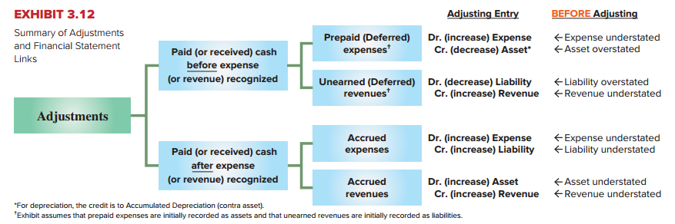
Links to Financial Statements
Learning Objective A1: Explain how accounting adjustments link to financial statements.
Notes:
This summary will prove very useful when completing your homework or studying for the next exam. Here is how we read the table. Before we adjust a prepaid expense, the assets of the company are overstated and the expenses are understated in the current period. The proper adjusting entry is to debit, or increase, an expense account and credit, or decrease, an asset account. Remember that each adjusting entry affects one or more income statement (revenue or expense) accounts and one or more balance sheet (asset or liability) accounts, but never the Cash account.
Take a few minutes to go over the remaining three types of adjusting entries before going to the next slide where we will use a spreadsheet to prepare the adjusting entries and financial statements.

Slide 59
P2:
Explain and prepare an adjusted trial balance.
Learning Objective

Slide 60
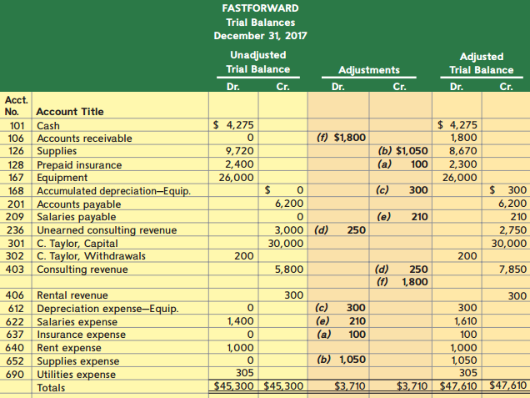
Adjusted Trial Balance
Exhibit 3.13
Learning Objective P2: Explain and prepare an adjusted trial balance.
Notes:
An unadjusted trial balance is a list of accounts and balances prepared before adjustments are recorded. An adjusted trial balance is a list of accounts and balances prepared after adjusting entries have been recorded and posted to the ledger. Here we show both the unadjusted and the adjusted trial balances for FastForward at December 31, 2017. The order of accounts in the trial balance is usually set up to match the order in the chart of accounts. Several new accounts arise from the adjusting entries.
Each adjustment (see middle columns) is identified by a letter in parentheses that links it to an adjusting entry explained earlier. Each amount in the Adjusted Trial Balance columns is computed by taking that account’s amount from the Unadjusted Trial Balance columns and adding or subtracting any adjustment(s).
Next, we will look at how to prepare financial statements from the adjusted trial balance.

Slide 61
P3:
Prepare financial statements from an adjusted trial balance.
Learning Objective

Slide 62
Preparing Financial Statements from an Adjusted Trial Balance
Step 1— Prepare income statement using revenue and expense accounts from trial balance.
Step 2—Prepare statement of owner’s equity using capital and withdrawals accounts from trial balance; and pull net income from step 1.
Step 3—Prepare balance sheet using asset and liability account from trial balance; and pull updated capital balance.
Step 4—Prepare statement of cash flows from changes in cash flows for the period (illustrated later in the book).
Learning Objective P3: Prepare financial statements from an adjusted trial balance.
Notes:
We can prepare financial statements directly from information in the adjusted trial balance. An adjusted trial balance includes all accounts and balances appearing in financial statements, and is easier to work from than the entire ledger when preparing financial statements.
Steps to Prepare Financial Statements
Step 1 Prepare income statement using revenue and expense accounts from trial balance
Step 2 Prepare statement of owner’s equity using capital and withdrawals accounts from trial balance; and pull net income from step 1
Step 3 Prepare balance sheet using asset and liability account from trial balance; and pull updated capital balance
Step 4 Prepare statement of cash flows from changes in cash flows for the period (illustrated later in the book)

Slide 63
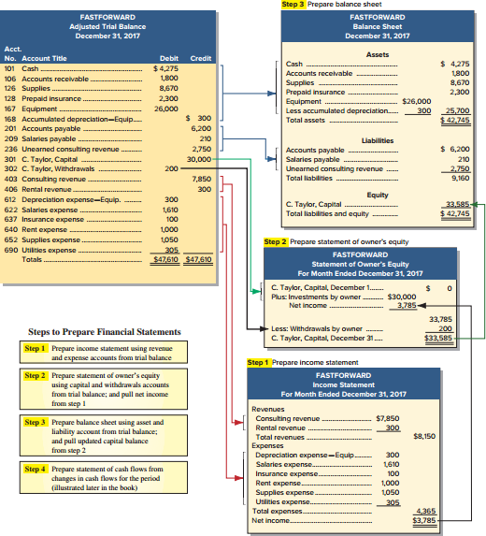
Preparing Financial Statements from an Adjusted Trial Balance
Exhibit 3.14
Learning Objective P3: Prepare financial statements from an adjusted trial balance.
Notes:
We can prepare financial statements directly from information in the adjusted trial balance. An adjusted trial balance includes all accounts and balances appearing in financial statements, and is easier to work from than the entire ledger when preparing financial statements.
Steps to Prepare Financial Statements
Step 1 Prepare income statement using revenue and expense accounts from trial balance
Step 2 Prepare statement of owner’s equity using capital and withdrawals accounts from trial balance; and pull net income from step 1
Step 3 Prepare balance sheet using asset and liability account from trial balance; and pull updated capital balance
Step 4 Prepare statement of cash flows from changes in cash flows for the period (illustrated later in the book)
Review what you have learned in the following NEED-TO-KNOW Slides.

Slide 64
NEED-TO-KNOW 3-5
Use the following adjusted trial balance of Magic Company to prepare its (1) income statement, (2) statement of
owner’s equity, and (3) balance sheet (unclassified), for the year ended, or date of, December 31, 2017. The
Magic, Capital account balance is $75,000 at December 31, 2016.
Magic Company
Trial Balance
December 31, 2017
Debit
Credit
Cash
$13,000
Accounts receivable
17,000
Land
85,000
Accounts payable
$12,000
Long-term notes payable
33,000
Magic, Capital
75,000
Magic, Withdrawals
20,000
Fees earned
79,000
Salaries expense
56,000
Office supplies expense
8,000
Totals
$199,000
$199,000
Learning Objective P3: Prepare financial statements from an adjusted trial balance.
Notes:
Use the following adjusted trial balance of Magic Company to prepare its (1) income statement, (2) statement of owner's equity, and (3) balance sheet (unclassified), for the year ended, or date of, December 31, 2017. The owner's capital account balance is $75,000 at December 31, 2016.

Slide 65
NEED-TO-KNOW 3-5 SOLUTION
Debit
Credit
Magic Company
Cash
$13,000
Income Statement
Accounts receivable
17,000
For Year Ended December 31, 2017
Land
85,000
Fees earned
$79,000
Accounts payable
$12,000
Expenses
Long-term notes payable
33,000
Salaries expense
$56,000
Magic, Capital
75,000
Office supplies expense
8,000
Magic Withdrawals
20,000
64,000
Fees earned
79,000
Net income
$15,000
Salaries expense
56,000
Office supplies expense
8,000
Totals
$199,000
$199,000
Learning Objective P3: Prepare financial statements from an adjusted trial balance.
Notes:
Since accounts on the trial balance are listed in financial statement order, assets first followed by liabilities, equity, revenue and expenses, it makes it pretty simple to prepare the financial statements.
Step 1 is to prepare the income statement. Fees earned is a revenue account, and is reported on the income statement. Salaries expense and office supplies expense are expense accounts, and subtracted on the income statement. Total expenses are $64,000, leaving net income of $15,000.

Slide 66
NEED-TO-KNOW 3-5 SOLUTION
Debit
Credit
Magic Company
Cash
$13,000
Income Statement
Accounts receivable
17,000
For Year Ended December 31, 2017
Land
85,000
Fees earned
$79,000
Accounts payable
$12,000
Expenses
Long-term notes payable
33,000
Salaries expense
$56,000
Magic, Capital
75,000
Office supplies expense
8,000
Magic Withdrawals
20,000
64,000
Fees earned
79,000
Net income
$15,000
Salaries expense
56,000
Office supplies expense
8,000
Magic Company
Totals
$199,000
$199,000
Statement of Owner’s Equity
For Year Ended December 31, 2017
Magic, Capital, Dec. 31 20X1
$75,000
Plus: Net income
15,000
Less: Magic, Withdrawals
(20,000)
Magic, Capital, Dec. 31 20X2
$70,000
Learning Objective P3: Prepare financial statements from an adjusted trial balance.
Notes:
Step 2 is to prepare the statement of owner’s equity. Magic, Capital is an equity account; its balance is reported on the statement of owner's equity as beginning capital. Withdrawals are subtracted on the statement of owner's equity. The amount of net income is added on the statement of owner's equity. Magic, Capital at the end of 2017 is $70,000.

Slide 67
NEED-TO-KNOW 3-5 SOLUTION
Debit
Credit
Magic Company
Cash
$13,000
Income Statement
Accounts receivable
17,000
For Year Ended December 31, 2017
Land
85,000
Fees earned
$79,000
Accounts payable
$12,000
Expenses
Long-term notes payable
33,000
Salaries expense
$56,000
Magic, Capital
75,000
Office supplies expense
8,000
Magic Withdrawals
20,000
64,000
Fees earned
79,000
Net income
$15,000
Salaries expense
56,000
Office supplies expense
8,000
Magic Company
Totals
$199,000
$199,000
Statement of Owner’s Equity
For Year Ended December 31, 2017
Magic, Capital, Dec. 31 20X1
$75,000
Plus: Net income
15,000
Less: Magic, Withdrawals
(20,000)
Magic, Capital, Dec. 31 20X2
$70,000
Magic Company
Balance Sheet
December 31, 2017
Assets
Liabilities
Cash
$13,000
Accounts payable
$12,000
Accounts receivable
17,000
Long-term notes payable
33,000
Land
85,000
Total liabilities
45,000
Equity
Magic, Capital
70,000
Total assets
$115,000
Total liabilities and equity
115,000
Learning Objective P3: Prepare financial statements from an adjusted trial balance.
Notes:
Step 3 is to prepare the balance sheet. Magic Company has three assets, Cash, Accounts receivable and Land, with total assets of $115,000. Liabilities include Accounts payable and Long-term notes payable, for a total of $45,000. The end-of-year capital balance is transferred to the balance sheet from the statement of owner’s equity. Total equity is $70,000. Total liabilities and equity, is $115,000.

Slide 68
A2:
Compute profit margin and describe its use in analyzing company performance.
Learning Objective

Slide 69
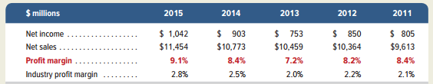
Profit Margin
Exhibit 3.16
The profit margin ratio measures the company’s net income to net sales.
Profit
Margin
Net Income
Net Sales
=
Limited Brands, Inc.
Learning Objective A2: Compute profit margin and describe its use in analyzing company performance.
Notes:
Profit margin is an important measure in business. It tells us about the relationship between sales and profits or net income. We calculate the ratio by dividing net income for the period by sales revenue. A high profit margin is an indicator of future growth.
You can see the profit margin at Limited Brands for the years 2011 through 2015. Limited’s average profit margin is 8.3% during this five-year period. This favorably compares to the average industry profit margin of 2.3%. Moreover, we see that Limited’s profit margin has rebounded from the recent recessionary period and is at the 7% to 9% margin for the past five years (see margin graph).

Slide 70
P4: Appendix 3A
Explain the alternatives in accounting for prepaids.
Learning Objective

Slide 71
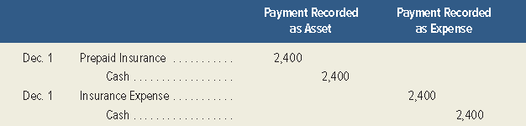
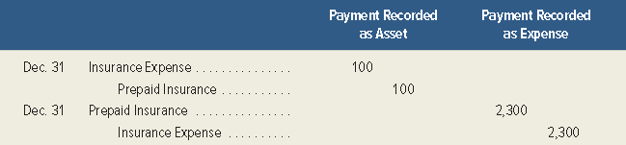
Appendix 3A: Alternative
Accounting for Prepayments
An alternative method is to record all prepaid expenses
with debits to expense accounts.
The adjusting entry depends on how the original payment
was recorded.
Exhibits 3A.1 & 3A.2
Learning Objective P4: Explain the alternatives in accounting for prepaids.
Notes:
Appendix 3A: Alternative Accounting for Prepayments
An alternative method is to record all prepaid expenses with debits to expense accounts. If any prepaids remain unused or unexpired at the end of an accounting period, then adjusting entries must transfer the cost of the unused portions from expense accounts to prepaid expense (asset) accounts. This alternative method is acceptable. The financial statements are identical under either method, but the adjusting entries are different. To illustrate the differences between these two methods, let’s look at FastForward’s cash payment of December 6 for 24 months of insurance coverage beginning on December 1. FastForward recorded that payment with a debit to an asset account, but it could have recorded a debit to an expense account. These alternatives are shown on this slide in the first graphic.
At the end of its accounting period on December 31, insurance protection for one month has expired. This means $100 ($2,400/24 months) of insurance coverage has expired and is an expense for December. The adjusting entry depends on how the original payment was recorded. This is shown on this slide in the second graphic.

Slide 72
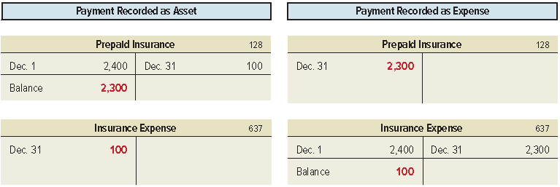
Appendix 3A: Alternative
Accounting for Prepayments
Exhibit 3A.3
Learning Objective P4: Explain the alternatives in accounting for prepaids.
Notes:
When these entries are posted to the accounts in the ledger, we can see that these two methods give identical results. The December 31 adjusted account balances show Prepaid Insurance of $2,300 and Insurance Expense of $100 for both methods.

Slide 73
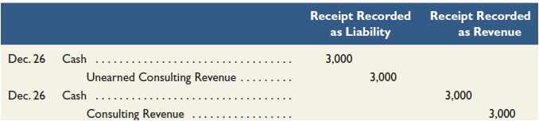
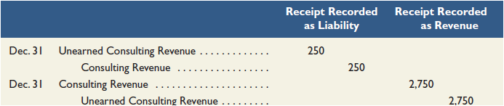
Appendix 3A: Alternative Accounting for Revenues
An alternative method is to record all revenues to a liability account or a revenue account.
The adjusting entry depends on how the original receipt
was recorded.
Exhibits 3A.4 & 3A.5
Learning Objective P4: Explain the alternatives in accounting for prepaids.
Notes:
An alternative method is to record all unearned revenues with credits to revenue accounts. If any revenues are unearned at the end of an accounting period, then adjusting entries must transfer the unearned portions from revenue accounts to unearned revenue (liability) accounts. This alternative method is acceptable. The adjusting entries are different for these two alternatives, but the financial statements are identical.
Assume FastForward’s December 26 receipt of $3,000 for consulting services covering the period December 27 to February 24. FastForward recorded this transaction with a credit to a liability account. The alternative is to record it with a credit to a revenue account.
By the end of its accounting period on December 31, FastForward has earned $250 of this revenue. This means $250 of the liability has been satisfied. Depending on how the initial receipt is recorded, the adjusting entry is as shown.

Slide 74
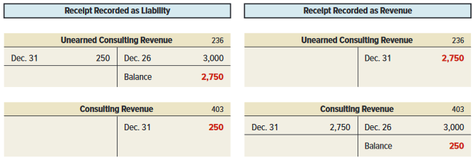
Appendix 3A: Alternative
Accounting for Revenues
Exhibit 3A.6
Learning Objective P4: Explain the alternatives in accounting for prepaids.
Notes:
When these entries are posted to the accounts in the ledger, we can see that these two methods give identical results. The December 31 adjusted account balances show Unearned Consulting Revenue of $2,750 and Consulting Revenue of $250 for both methods.

Slide 75
End of Chapter 3

